Slide 1

Gokaraju Rangaraju Institute of Engineering and Technology
(Autonomous)
Department of Data Science
Batch No.: DSC06
Review No.: 01
IV Year B. Tech., I Semester CSE (Data Science)
A Multi-Agent Agentic RAG Platform for Automated
Literature Review
Under the Guidance of:
Dr. S. Govinda Rao
Head of Department,
Data Science
Presented by:
1. Mr. Abrarullah Mohammed(23241A67D1)
2. Mr. G. Shashivadan Rao (23241A67F2)
3. Mr. P. Sreekaran Reddy (23241A67H7)

Slide 2
A Multi-Agent Agentic RAG Platform for Automated Literature Review

Slide 3
Abstract
  The project aims to build a multi-agent agentic RAG system that automates academic literature review using six specialized agents — Planner, Retriever, Extractor, Verifier, Critic, and Writer —using LangGraph. The Retriever pulls papers from Semantic Scholar and OpenAlex, the Extractor embeds content into a pgvector store, and the Verifier and Critic ensure factual grounding and coverage completeness, looping back to retrieval when gaps are found. A FastAPI backend streams live agent progress to a Vue.js frontend, giving users real-time visibility into the review as it's generated.

Slide 4
Abstract
This project develops a multi-agent agentic Retrieval-Augmented Generation (RAG) platform that automates academic literature review generation. Six specialised agents — Planner, Retriever, Extractor, Verifier, Critic and Writer — are orchestrated as a stateful LangGraph state machine. The Retriever performs federated search over the Semantic Scholar Academic Graph, and an ingestion stage parses full-text PDFs, chunks them section-aware and embeds them on CPU into a Chroma vector store; the Extractor then emits a four-field structured insight for every paper together with character-level evidence spans. The Verifier decomposes those insights into atomic claims and classifies each one against its evidence span using a claim-verification model fine-tuned on SciFact and exported to ONNX int8 for CPU inference, discarding every claim that falls below the support threshold. The Critic then assesses coverage and grounding and returns control to retrieval or planning for at most three bounded iterations, while a human-in-the-loop console lets the analyst confirm or override flagged and dropped claims before writing begins. A FastAPI backend streams live agent progress over Server-Sent Events to a Vue 3 frontend that displays the finished review with clickable evidence spans and downloadable artefacts, and the entire system runs at zero API cost on CPU-only hardware.

Slide 5
Introduction
Literature review is manual and time-intensive, with no reliable end-to-end automation.
The project automates it using six specialized agents (Planner, Retriever, Extractor, Verifier, Critic, Writer) orchestrated via LangGraph.
A verification and critique loop checks grounding and coverage, re-triggering retrieval when gaps are found.
Delivered as a full app: FastAPI backend streaming live progress to a Vue.js frontend.

Slide 6
Objectives of the Proposed Work
To Automate end-to-end literature review using a multi-agent agentic RAG pipeline.
To Ensure factual grounding and coverage completeness via verification and critique loops and Human-in-the-loop.
To Deliver a usable full-stack application with real-time progress visibility.

Slide 7
Software & Hardware Requirements
Minimum Software Requirements
  OS: Windows with Docker
  Languages: Python(3.13+),Node.js(18+)
  Frameworks: FastAPI, Langraph
  APIs: Semantic Scholar, OpenAlex
Minimum Hardware Requirements
  Processor: Dual core 2.0 GHZ
  GPU: 8GB Minimum
  RAM: 16GB Minimum
  Stable Internet

Slide 8
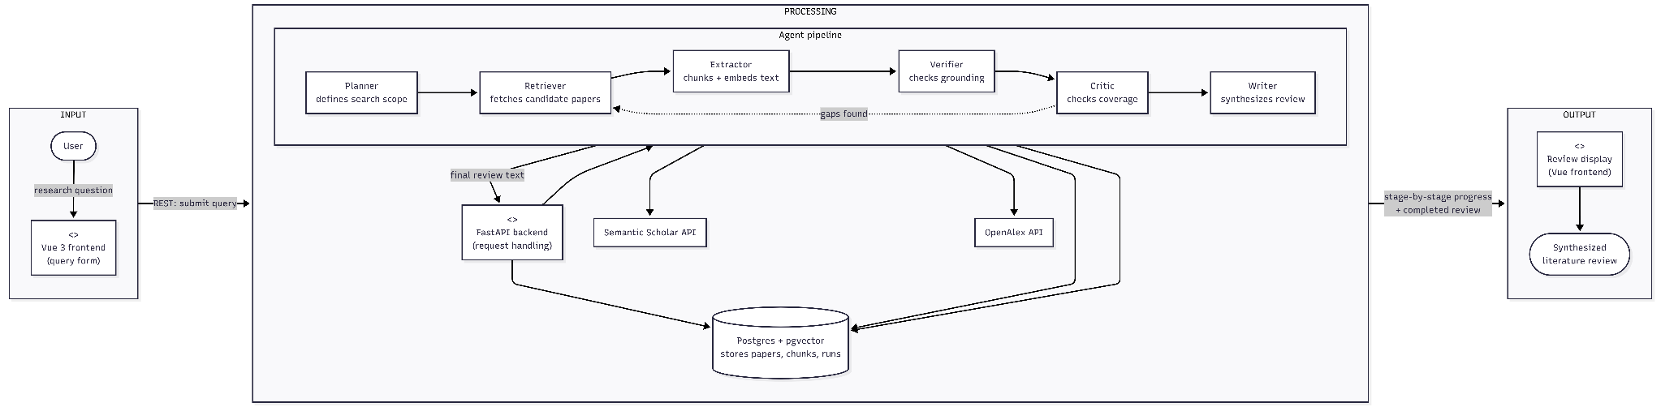
Proposed Method: Architecture Diagram

Slide 9
Proposed Method: Architecture Diagram
Input: User submits a research query through the Vue.js frontend, sent via REST to the FastAPI backend.
Orchestration: FastAPI hands the query to a LangGraph-managed agent pipeline and streams progress back.
Processing: Six agents run in sequence — Planner scopes the query, Retriever fetches papers (Semantic Scholar/OpenAlex), Extractor chunks and embeds them, Verifier checks grounding, and Critic checks coverage — with Critic looping back to Retriever if gaps are found.

Slide 10
Proposed Method: Architecture Diagram
Storage: PostgreSQL with pgvector persists paper metadata, chunks, and embeddings throughout processing.
Output: Once approved, the Writer agent synthesizes the final literature review, which is streamed back and displayed in the frontend.

Slide 11
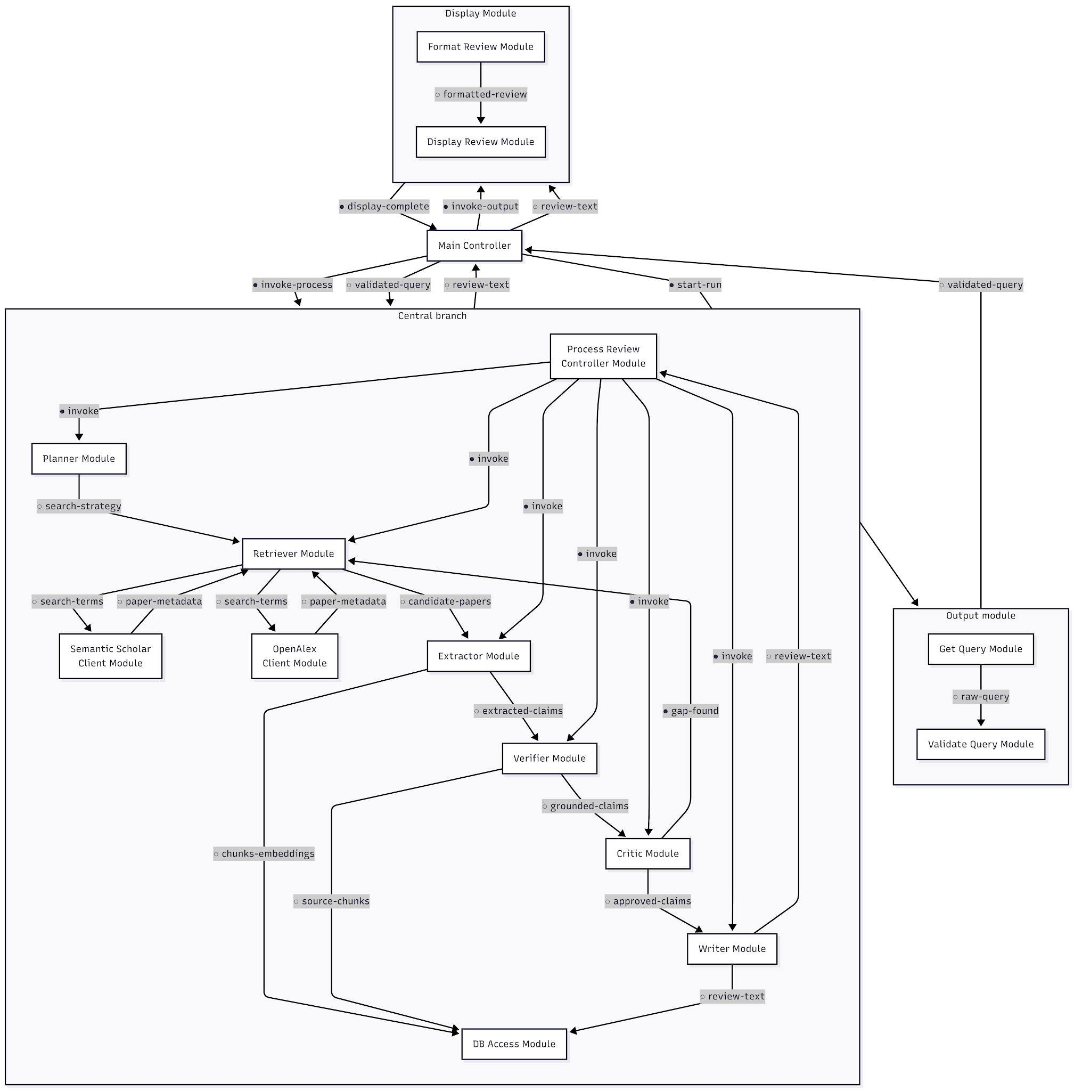
Proposed Method: Module Connectivity Diagram

Slide 12
Proposed Method: Module Connectivity Diagram
Structure: A Main Controller sits at the top and delegates to three branches — input, processing, and output — with strict one-parent-per-module calling, forming a clean tree.
Input branch: Get Query and Validate Query modules capture and clean the user's request before handing validated data back up to Main.
Processing branch: Process Review Controller invokes Planner, Retriever, Extractor, Verifier, Critic, and Writer in sequence, each passing data couples (papers, chunks, claims) to the next stage.

Slide 13
Proposed Method: Module Connectivity Diagram
Coupling: Data couples (○) carry actual information between modules, while control couples (●) carry signals like "invoke" or "gap-found”.
Output branch: Format Review and Display Review modules take the finished review text from Main and present it, completing the flow with an acknowledgment signal back up.

Slide 14
References
M. Shao, A. Basit, R. Karri, and M. Shafique, "Survey of Different Large Language Model Architectures: Trends, Benchmarks, and Challenges," IEEE Access, vol. 12, 2024, doi: 10.1109/ACCESS.2024.3482107.
S. Li, Y. Yu, H. Yang, Y. Zhou and C. Ji, "HIM-RAG: A Heuristic Framework for Iterative Multi-Source Retrieval-Augmented Generation," 2025 International Joint Conference on Neural Networks (IJCNN), Rome, Italy, 2025, pp. 1-8, doi: 10.1109/IJCNN64981.2025.11229295.
S. Pan, L. Luo, Y. Wang, C. Chen, J. Wang, and X. Wu, "Unifying Large Language Models and Knowledge Graphs: A Roadmap," IEEE Trans. Knowl. Data Eng., vol. 36, no. 7, pp. 3580–3599, 2024, doi: 10.1109/TKDE.2024.3352100.
N. Nascimento, P. Alencar and D. Cowan, "Self-Adaptive Large Language Model (LLM)-Based Multiagent Systems," 2023 IEEE International Conference on Autonomic Computing and Self-Organizing Systems Companion (ACSOS-C), Toronto, ON, Canada, 2023, pp. 104-109, doi: 10.1109/ACSOS-C58168.2023.00048.
S. Bag, A. Gupta, R. Kaushik and C. Jain, "RAG Beyond Text: Enhancing Image Retrieval in RAG Systems," 2024 International Conference on Electrical, Computer and Energy Technologies (ICECET, Sydney, Australia, 2024, pp. 1-6, doi: 10.1109/ICECET61485.2024.10698598.

Slide 15
References
Singh, A. Ehtesham, S. Mahmud and J. -H. Kim, "Revolutionizing Mental Health Care through LangChain: A Journey with a Large Language Model," 2024 IEEE 14th Annual Computing and Communication Workshop and Conference (CCWC), Las Vegas, NV, USA, 2024, pp. 0073-0078, doi: 10.1109/CCWC60891.2024.10427865.
K. R. Felizardo, S. R. S. Souza, and J. C. Maldonado, "The Use of Visual Text Mining to Support the Study Selection Activity in Systematic Literature Reviews: A Replication Study," in Proc. 2013 3rd Int. Workshop Replication in Empirical Software Engineering Research (RESER), 2013, doi: 10.1109/RESER.2013.9.
T. Sakurai, S. Shiramatsu and R. Kinoshita, "LLM-based Agent for Recommending Information Related to Web Discussions at Appropriate Timing," 2024 IEEE International Conference on Agents (ICA), Wollongong, Australia, 2024, pp. 120-123, doi: 10.1109/ICA63002.2024.00033.
E. A. Calvillo, A. Padilla, J. Muñoz, J. Ponce and J. T. Fernandez, "Searching research papers using clustering and text mining," CONIELECOMP 2013, 23rd International Conference on Electronics, Communications and Computing, Cholula, Puebla, Mexico, 2013, pp. 78-81, doi: 10.1109/CONIELECOMP.2013.6525763.

Slide 16
References
Y. Wei, W. Li, and J. Han, "DKF-RAG: Dynamic Knowledge Fusion-Enhanced Retrieval-Augmented Generation," in Proc. 2025 IEEE Int. Conf. Systems, Man, and Cybernetics (SMC), 2025, pp. 2338–2343, doi: 10.1109/SMC58881.2025.11343223.
R. Van Dinter, B. Tekinerdogan, and C. Catal, "Automation of Systematic Literature Reviews: A Systematic Literature Review," Inf. Softw. Technol., vol. 136, p. 106589, 2021. DOI: 10.1016/j.infsof.2021.106589
Salemi, M. Maddipatla, and H. Zamani, "CIIR@LiveRAG 2025: Optimizing Multi-Agent Retrieval-Augmented Generation through Self-Training," in Proc. SIGIR 2025 LiveRAG Workshop / arXiv:2506.10844.
Y. Du, S. Li, A. Torralba, J. B. Tenenbaum, and I. Mordatch, "Improving Factuality and Reasoning in Language Models through Multiagent Debate," in Proc. ICML 2024, pp. 11733–11763, DOI: doi/10.5555/3692070.3692537
N. Shinn, F. Cassano, A. Gopinath, K. Narasimhan, and S. Yao, "Reflexion: Language Agents with Verbal Reinforcement Learning," in Proc. NeurIPS 2023, DOI: doi/10.5555/3666122.3666499

Slide 17
References
Y. Du, S. Li, A. Torralba, J. B. Tenenbaum, and I. Mordatch, "Improving Factuality and Reasoning in Language Models through Multiagent Debate," in Proc. ICML 2024, pp. 11733–11763. DOI:10.5555/3692070.3692537
A. Asai, Z. Wu, Y. Wang, A. Sil, and H. Hajishirzi, "Self-RAG: Learning to Retrieve, Generate, and Critique through Self-Reflection," in Proc. ICLR 2024. DOI: 10.48550/arXiv.2310.11511
Soyeong Jeong, Jinheon Baek, Sukmin Cho, Sung Ju Hwang, and Jong Park. 2024. ”Adaptive-RAG: Learning to Adapt Retrieval-Augmented Large Language Models through Question Complexity”. In Proceedings of the 2024 Conference of the North American Chapter of the Association for Computational Linguistics: Human Language Technologies (Volume 1: Long Papers), pages 7036–7050, DOI:10.18653/v1/2024.naacl-long.389.

